Slide 1
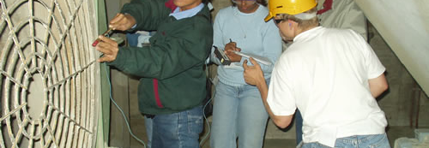
Tools day - Standard Tools from TT
Technical Development Program SPREAD 2016

Slide 2
Objectives/Coaches of the day
Get to know the Thermal Technology Standard tools
Be able to use the tools in order to detect areas for optimization and define related actions
Learn how to interpret measurement results
Know common guide values
Be able to benchmark your kiln system

Slide 3
Time planning/Tools Required
Required tools
Paper and Pen
Pocket calculator
Laptop
PPE Reference guide
Handouts and files will be distributed by coaches
Program
Introduction to tools, preparation and measurements by tool responsible in plenum
Detailed discussion and hands-on application of tools in groups
Wrap-up and summary in groups
Do calculations individually
Notes:
Time plan is fake not real one!!!

Slide 4
Group Formation

Slide 5
Practical Afternoon Posts
 | Group A | Group B | Group C | Group D
10:30 12:05 | Burner Check | Heat Balance | PH Profile | Cooler Air
12:10 14:45 | Cooler Air | Burner Check | Heat Balance | PH Profile
14:50 16:35 | PH Profile | Cooler Air | Burner Check | Heat Balance
16:40 18:10 | Heat Balance | PH Profile | Cooler Air | Burner Check

Slide 6
Updated Timing Guideline
Time | Standard Tools & Measurements | Responsible
08:30 - 09:00 | Introduction | Stefan Gross
09:00 - 09:45 | A/S tool | Stefan Gross
09:50 - 10:05 | 1st tool | Coaches
 | Coffee Break
10:30 - 11:30 | 1st tool (cont’d) | Coaches
11:35 - 12:50 | 2nd tool | Coaches
 | LUNCH
14:00 - 15:15 | 3rd tool | Coaches
15:20 - 15:35 | 4th tool | Coaches
 | Coffee Break
15:40 – 16:40 | 4th tool (cont’d) | Coaches
16:45 - 17:30 | Summary of the process problems and of the findings | Groups

Slide 7
Introduction
=
Standard Measurements = Check Routines

Slide 8
Introduction
one year
Heat- & Mass - Balance
every two years

Combustion - Check
Burner - Check
Cooler Air Distribution

Frequency of Standard Measurements for Kilns
False Air Investigation

T & p profile in PH
yearly kiln stop
Alk-Sulphur-Cl Balance

Instrumentation Check

Calibration of Feeders

 Required before and after major modifications or process changes of the kiln system

Slide 9
Introduction
Preconditions for standard measurements
Stable and representative kiln operation
Kiln close to nominal production rate
Stable and normal coating situation
No major process adjustments in the last 24 h

Slide 10
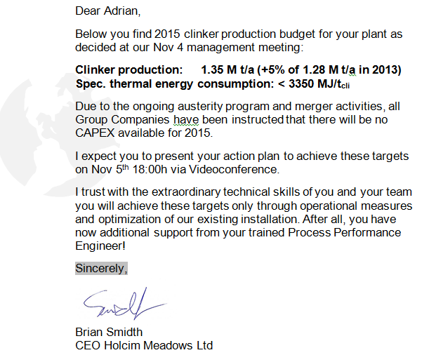
Situation
Dear Plant Manager
Notes:
Not shown, Plant manager will show the letter with the presenter..

Slide 11
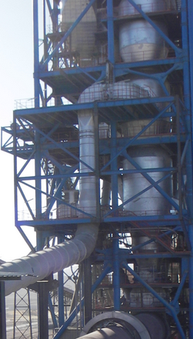
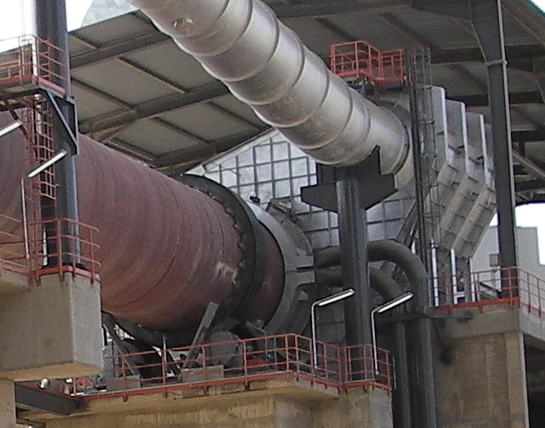
Kiln System Design
5 stage precalciner kiln
Inline calciner (5s residence time)
High momentum burner
Grate cooler with fixed inlet
Ter. Air
Meal
Ter. Air
Fuel
Fuel

Slide 12
Kiln System Operation
Fuels:
Coal / Petcoke mix (80/20)
Fluff (2.03 t/h at main burner)
Plastics (4.26 t/h at precalciner)
Availability: 87%, Production rate index: 92%
Several stops for riser duct and cyclone cleaning
Clinker temperature causes problems with belt to cement mill
Tertiary air damper removed due to abrasion
ID fan close to maximum speed

Slide 13
Downtime Pareto

Slide 14
Kiln Stop Pareto

Slide 15
Main Tasks
Analysis of kiln operation : paretos, operation and quality trends long/ short term (TIS, LIMS,…)
Assessment of kiln line
heat balance
burner check
cooler air distribution
alkali-sulfur-chlorine balance
preheater assessment
Evaluation of measurements and conclusions
Define required steps to overcome current issues and to achieve defined targets

